Slide 1

Login Testing
14/09/2025
Ensuring Secure and Reliable Login through Functional and Boundary Testing

Slide 2

Objectives
The key objectives of this project are:
To validate correct and incorrect login credential handling.
To test field validations for empty inputs, long strings, and invalid characters.
To ensure error messages are clear and user-friendly.
To apply boundary value analysis for edge cases like maximum input length.
To perform basic security checks such as SQL injection and password strength validation.
To generate pass/fail reports for each test case.

Slide 3

What is Login Form Testing and what it does?
Login Form Testing is a software testing process focused on verifying the functionality, security, and reliability of a system’s login page — the primary entry point for users. It ensures that only authorized users can gain access, while invalid inputs are properly handled to prevent errors or vulnerabilities.
Traditional Login Testing: – Focuses mainly on checking valid/invalid credentials, empty fields, and basic input validation.
Advanced Login Testing: – Includes boundary value testing, special characters, SQL injection checks, password strength validation, and usability checks to ensure both security and user experience.

Slide 4
How Login Form Testing Works
Functional Validation –Checks whether the login form correctly accepts valid credentials and rejects invalid ones.
Input Handling –Ensures the form properly processes empty fields, long inputs, and special characters without breaking.
Error Message Verification –Confirms that clear, user-friendly messages appear for wrong credentials or missing fields.
Boundary Testing –Tests edge cases such as maximum username/password length and multiple failed attempts.
Security Checks –Validates that the login form is protected against common attacks like SQL injection or brute-force attempts.

Slide 5
What we are doing?
We’re making sure the login page — the first gateway into any system — is secure, reliable, and user-friendly. A login form that isn’t properly tested can let in attackers or frustrate real users.
By applying systematic testing methods, we check everything:
Does the form accept correct credentials and reject wrong ones?
Does it handle empty fields, long inputs, and special characters properly?
Are error messages clear without exposing sensitive details?
Is it safe against common attacks like SQL injection or brute force attempts?
In short, we are stopping login-level issues at the very start, ensuring that only authorized users get access while blocking unauthorized ones effectively.

Slide 6

How we are doing?
Test Design – We prepare different test cases covering valid logins, invalid logins, empty fields, long inputs, and special characters.
Execution – These test cases are run step by step on the login form to check how it behaves in each situation.
Validation – We verify whether the system gives correct responses: successful login for valid inputs, proper error messages for wrong inputs, and secure rejection of harmful attempts.
Security Testing – Extra checks are added for attacks like SQL injection, brute-force attempts, and password strength validation to make sure the system cannot be bypassed.
By combining functional tests, boundary tests, and security checks, we ensure that the login form works correctly, is user-friendly, and blocks unauthorized access right at the entry point.

Slide 7
Tools and Technologies Used
1.Manual Testing:
Word/Excel/Sheets: Write test cases for valid/invalid inputs and error messages.
Boundary Value & Equivalence Partitioning: Test edge cases like empty fields or max-length inputs.
2.Automation Testing:
Selenium : Automate login tests in browsers for repeated scenarios.
JUnit : Test backend login logic automatically.
3.API Testing:
Postman: Manually check login API responses.

Slide 8
4.Security Testing:
Password Strength Checkers : Ensure passwords meet security rules.
5.Test & Bug Management:
Jira : Track bugs and testing progress.

Slide 9
Login Form Test Case Scenarios
1. Valid Credentials
2. Invalid Username
3. Invalid Password
4. Empty Username
5. Empty Password
6. Both Fields Empty
7. Special Characters in Username
8. Special Characters in Password
9. Maximum Length Inputs
10. Minimum Length Inputs
11. Case Sensitivity Test
12. Leading/Trailing Spaces
13. Multiple Failed Login Attempts
14. Stay Logged In
15. Forgot Password Flow
16. Login After Password Change
17. Session Timeout

Slide 10
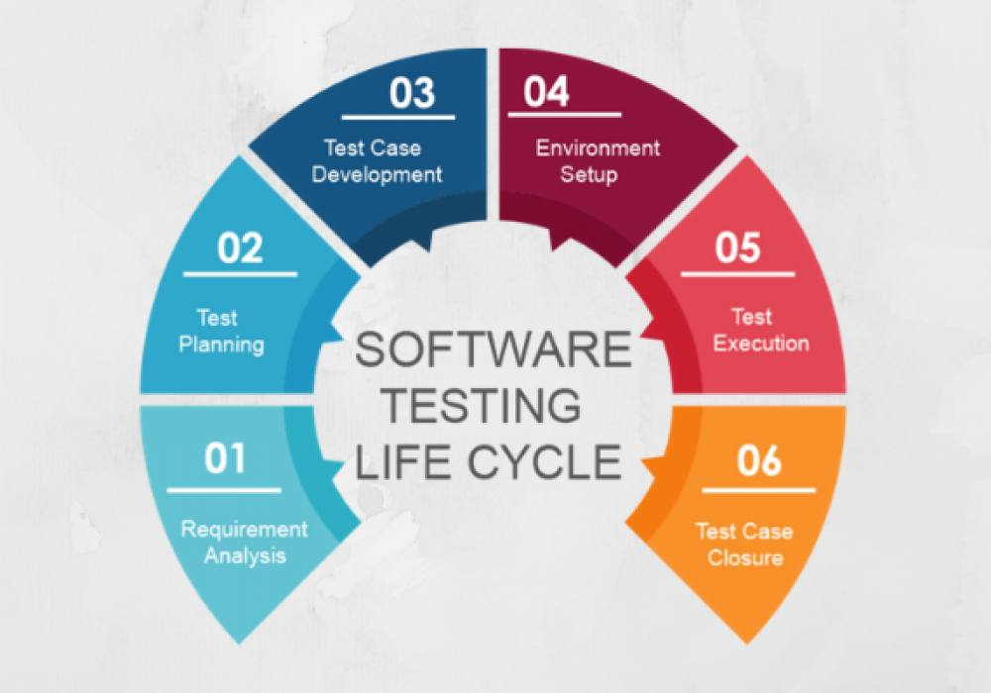

Slide 11
Expected Outcomes
Secure Login Form – Only valid users can access the system; unauthorized access is blocked.
Reliable Functionality – The form works correctly under normal and unexpected inputs.
Clear Error Messages – Users receive understandable messages for wrong username/password or invalid input.
Boundary Handling – The form handles very short, very long, or empty inputs properly.
Protection Against Common Attacks – The system resists SQL injection, script injection, and repeated login attempts.
User-Friendly Design – Easy to use and reduces user frustration.
Validation Checks – Input fields are validated for correct format (like email format, password rules).
Consistent Behavior – Works the same way on different browsers or devices.
Black-Box Tested – Verified from a user’s perspective without accessing the internal code.

Slide 12
Thanks for your attention

